Slide 1
Logistic Regression

Slide 2
Logistic regression is a supervised machine learning algorithm that accomplishes binary classification tasks by predicting the probability of an outcome, event, or observation. The model delivers a binary or dichotomous outcome limited to two possible outcomes: yes/no, 0/1, or true/false.
Logical regression analyzes the relationship between one or more independent variables and classifies data into discrete classes. It is extensively used in predictive modeling, where the model estimates the mathematical probability of whether an instance belongs to a specific category or not.
For example, 0 – represents a negative class; 1 – represents a positive class. Logistic regression is commonly used in binary classification problems where the outcome variable reveals either of the two categories (0 and 1).

Slide 3
Some examples of such classifications and instances where the binary response is expected or implied are:
Determine the probability of heart attacks: With the help of a logistic model, medical practitioners can determine the relationship between variables such as the weight, exercise, etc., of an individual and use it to predict whether the person will suffer from a heart attack or any other medical complication.
Possibility of enrolling into a university: Application aggregators can determine the probability of a student getting accepted to a particular university or a degree course in a college by studying the relationship between the estimator variables, such as GRE, GMAT, or TOEFL scores.
Identifying spam emails: Email inboxes are filtered to determine if the email communication is promotional/spam by understanding the predictor variables and applying a logistic regression algorithm to check its authenticity.

Slide 4
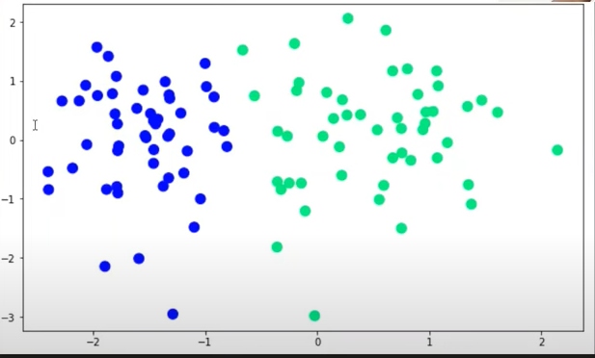
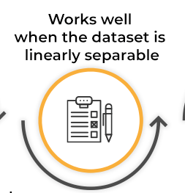
Prerequisite to apply Logistic Regression
Suitable for linearly separable datasets: A linearly separable dataset refers to a graph where a straight line separates the two data classes. In logistic regression, the y variable takes only two values. Hence, one can effectively classify data into two separate classes if linearly separable data is used.

Slide 5
Types of Logistic Regression
Binary Logistic Regression
Binary logistic regression is the most common type of logistic regression, where the dependent variable has only two possible outcomes or classes, typically represented as 0 and 1. It is used when the target variable is binary, such as yes/no, pass/fail, or true/false. The logistic function in binary logistic regression models the probability of an observation belonging to one of the two classes.

Slide 6
Multinomial logistic regression
In this type of logistic regression model, the dependent variable has three or more possible outcomes; however, these values have no specified order. For example, movie studios want to predict what genre of film a moviegoer is likely to see to market films more effectively. A multinomial logistic regression model can help the studio to determine the strength of influence a person's age, gender, and dating status may have on the type of film that they prefer. The studio can then orient an advertising campaign of a specific movie toward a group of people likely to go see it

Slide 7
Ordinal logistic regression: This type of logistic regression model is leveraged when the response variable has three or more possible outcome, but in this case, these values do have a defined order. Examples of ordinal responses include grading scales from A to F or rating scales from 1 to 5.

Slide 8
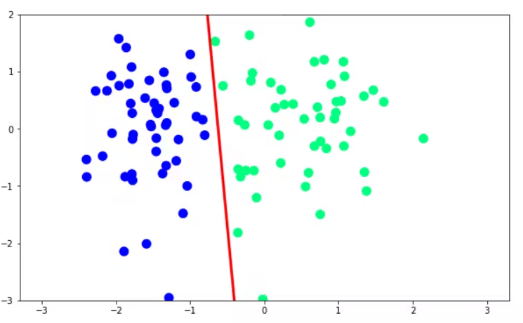
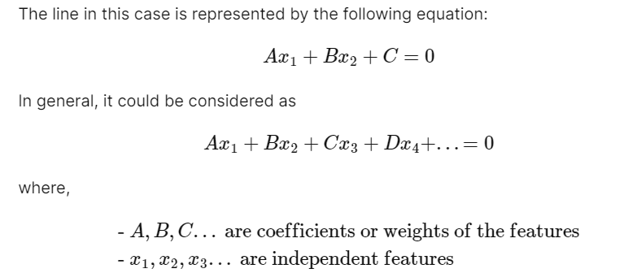
Perceptron Trick
Our goal is to find a line that separates the data perfectly as given below.
X1 is CGPA,X2 is IQ,C is y intercept

Slide 9
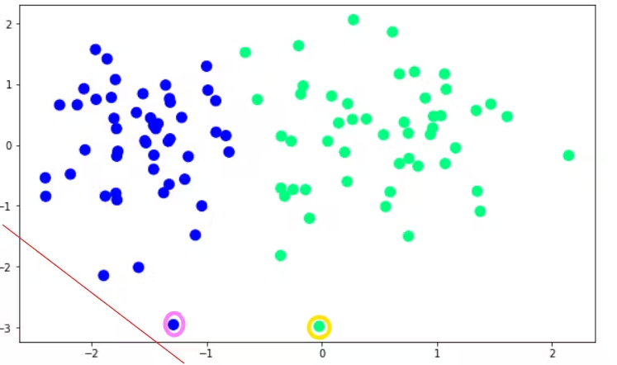
In perceptron method, my aim to to find the value of A,B and C so that line should divide data in 2 parts.
Perceptron trick works in the most simple way imaginable.It says we have to run a loop lets say 100 times(epochs) Firstly, you start with random values of A, B and C. You can start with A=B=C=1.
For example, we initially start with the red line shown in the figure

Slide 10
Then, we pick a random point and check if the point lies on the correct side of the line or not.
There are two scenarios to consider after we pick a point:
If a point is correctly classified, do nothing
If a point is incorrectly classified, adjust the line in such a way that it is classified.
Thus, when we pick a point yellow circled in the figure given below, we see that it is correctly classified and we do nothing.
However, when we pick the pink circled point we do some transformations on the line because it is on the wrong side of the line
The above procedure is repeated multiple times in a loop to get the desired line.
As per current example, blue points should be on the left of the line and green must be on the right side of the line.

Slide 11
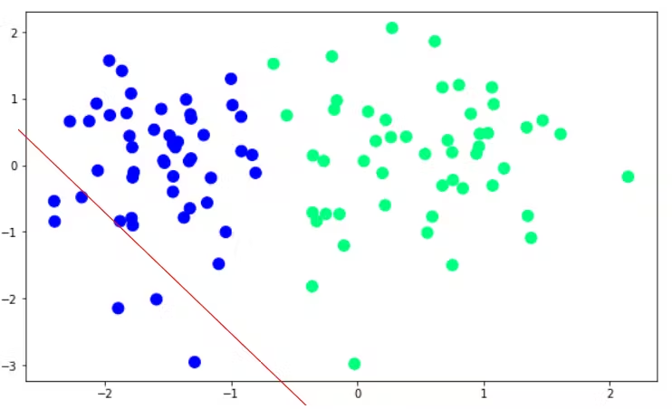
After applying transformations, the point is correctly classified as shown below:
This process will go on until convergence (that means there is no mis classification)

Slide 12
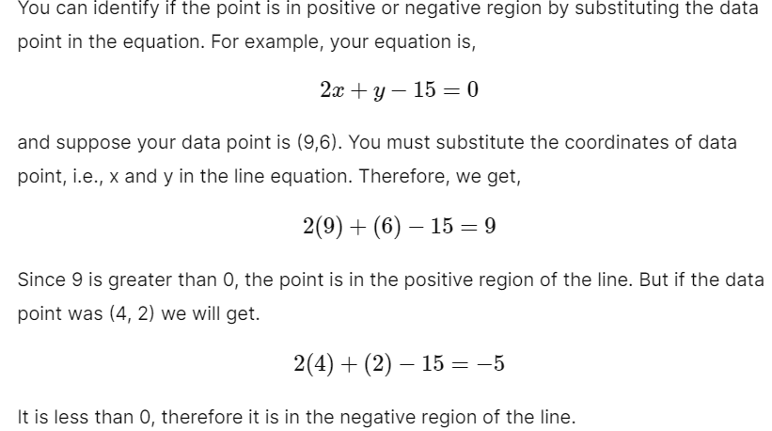
How to label region +ve or -ve
https://www.desmos.com/calculator

Slide 13
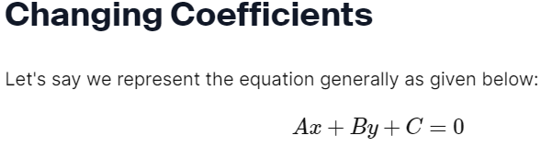
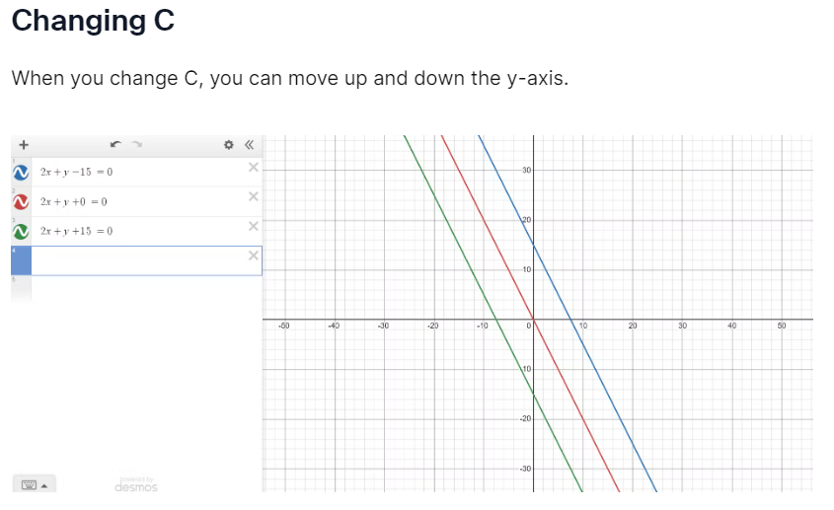
How transformations are happening

Slide 14
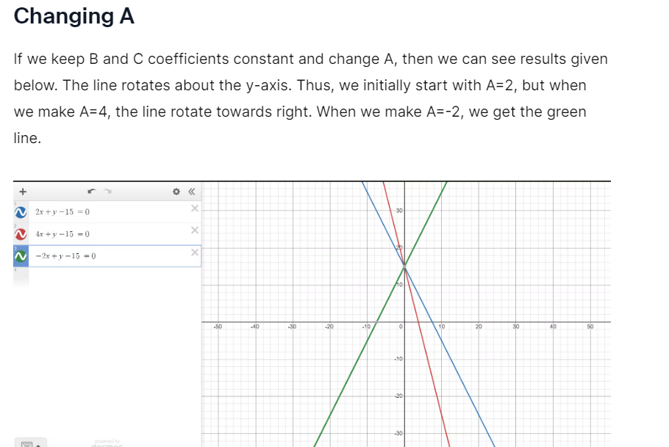
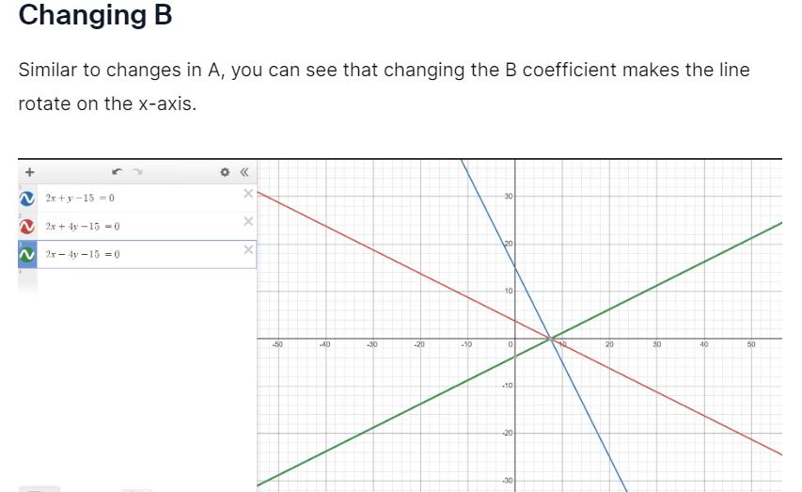

Slide 15
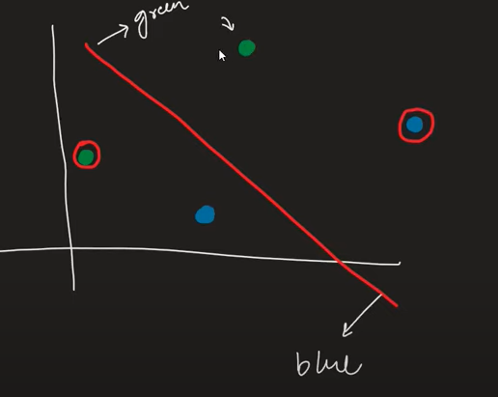
Transformations
Here in 2 points no change is required as
they are placed correctly but for other 2
points we have to make changes.

Slide 16
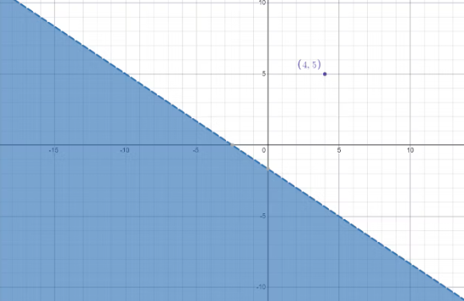
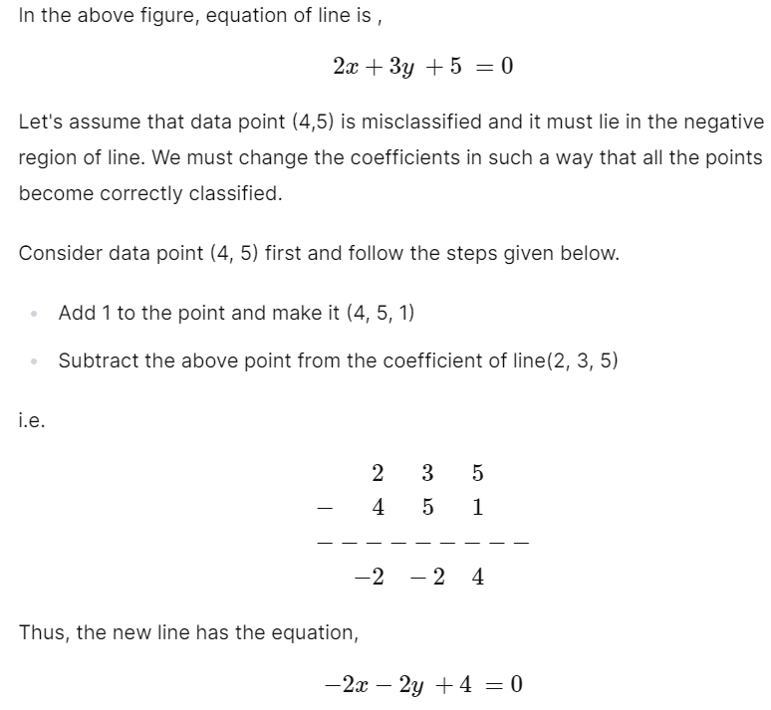
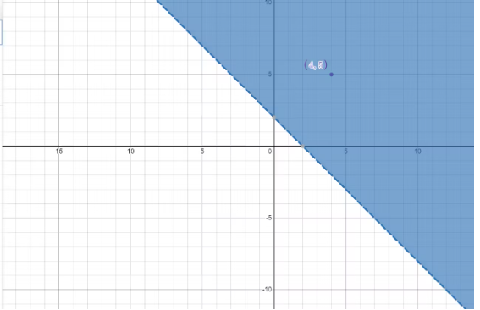
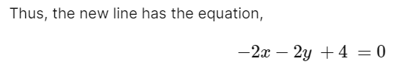
CASE 1: Point lies in the positive region but we want it in negative region

Slide 17
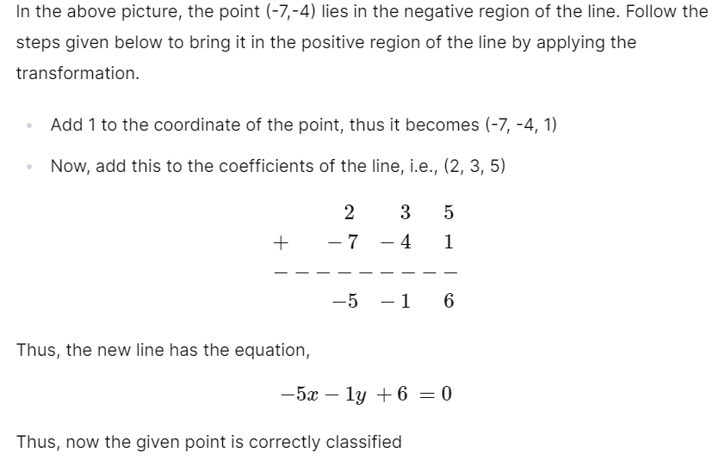
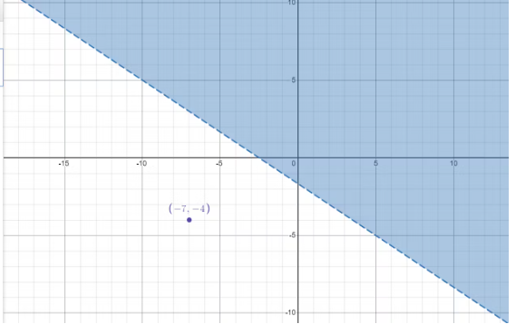
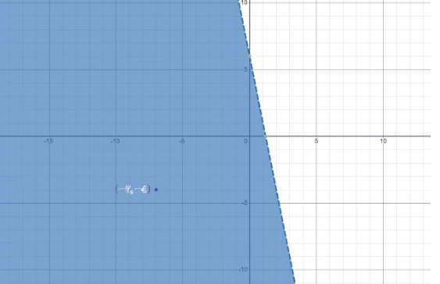
CASE 2: Point lies in negative region and we want it in positive region.

Slide 18
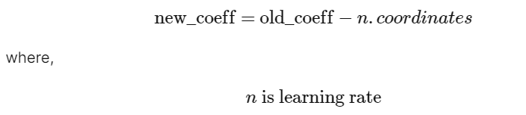
In short, we add/subtract the coordinates of the data point from the coefficients of the equation. This will make sure the chosen point is in the correct region. However, we do not directly subtract the coordinates from coefficients because it causes the line to change drastically. Thus, to make the changes slow we first multiply coordinated by the learning rate and then add or subtract it according to the situation.
In a nutshell, the process works like this,
We choose a random data point and check if it is correctly classified
If it is correctly classified we do nothing
If it isn't correctly classified, we apply a transformation
We create a loop and repeat from step 1 for an appropriate number of epochs or until all the data points are picked and correctly classified.
Therefore,

Slide 19
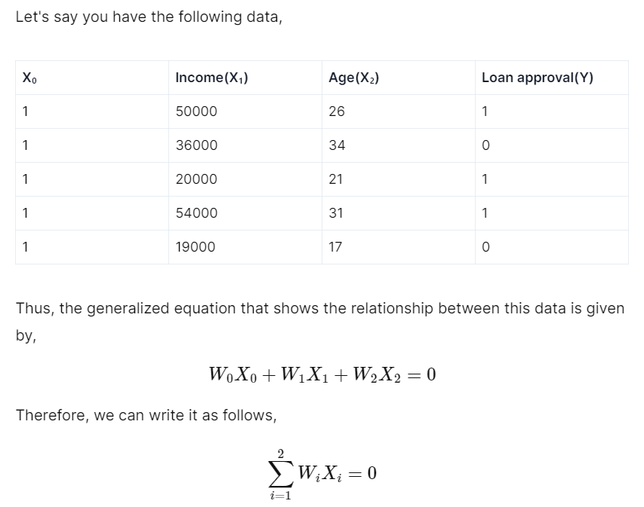
Algorithm
Now since the model is ready, we have values of W1,W2and W0.
When we substitute these values and if resultant value is greater than 0 that means loan will get approve.
If less than 0 then loan will not get approve

Slide 20
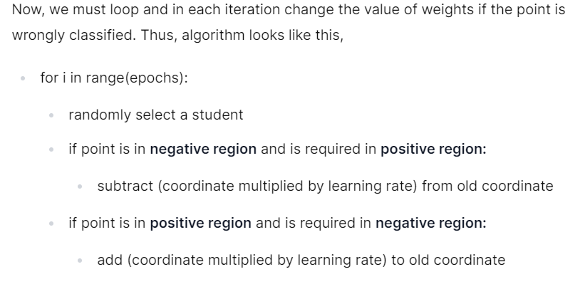

Slide 21
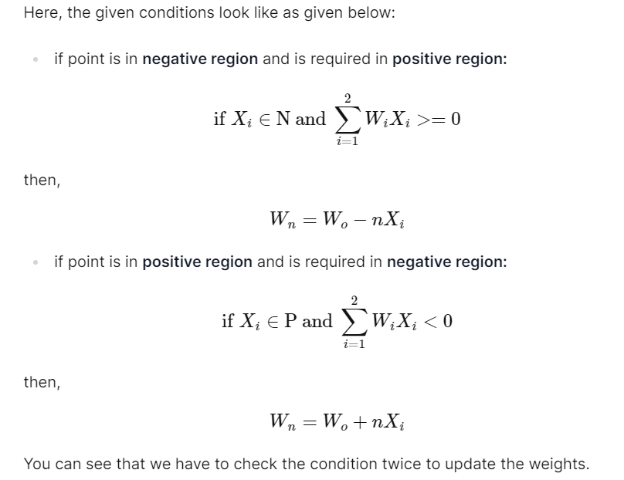

Slide 22
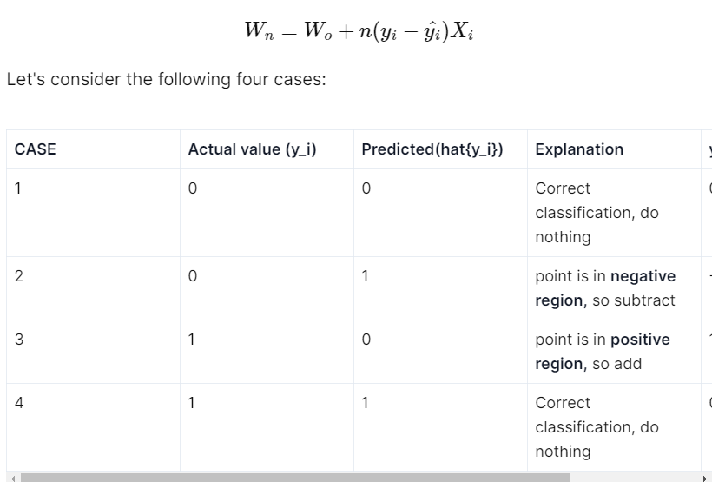
Therefore, to simplify further, we multiply the learning rate with (actual value - predicted value)
Thus, in new algorithm, we do not need to check anything using if condition, we simply replace them by the following one equation:

Slide 23
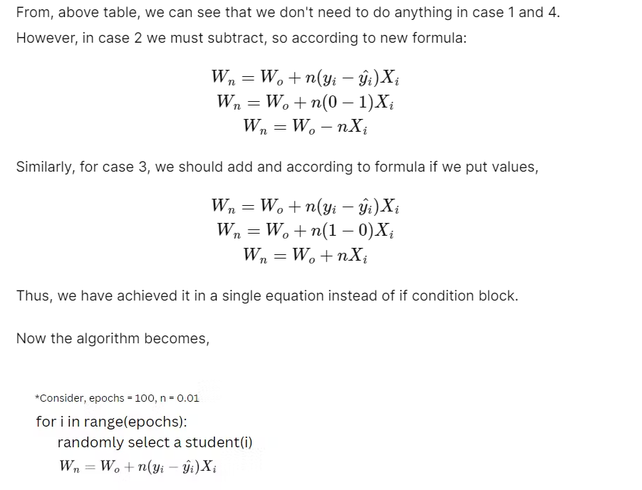

Slide 24
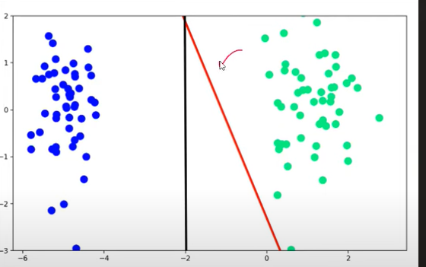
Comparison of Logistic Regression Model and Perceptron Model

Slide 25
The perceptron trick runs loop 1000 times and every time we are picking one data point randomly and checking if it is misclassified or not.
If not,then no change in line but if it is misclassified then we are moving line towards that point.
At end our solution converge properly, but when compared with logistic regression model, it was performing better.

Slide 26
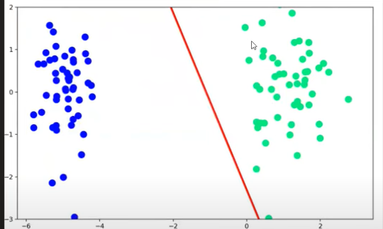
There is flaw in our algorithm which we need to change.
Till now our algorithm was saying that we will change line only when point is misclassified but if point is at proper place then it will have no say.
So now the new improved model will have say of both correctly classified and not correctly classified datapoints.
Till now misclassified points pull line towards them and now in new function,properly classified points will push line away from them
That means when this point is reached
Then correctly placed points push line away from them
So a equilibrium will reach.
This push and pull will also depend on distance of
Point from the line

Slide 27
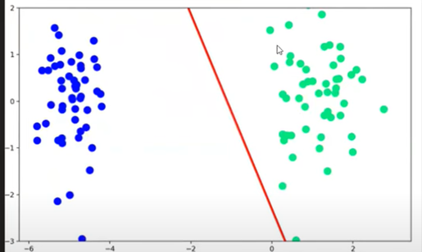
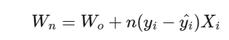
Condition 1:If point is misclassified and close to line, then it will pull line with less force.
Condition 2:If point is misclassified and far away from line, then it will pull line with more force.
Condition 3:If point is correctly classified and close to line, then it will push line with more force.
Condition 4:If point is correctly classified and far from line, then it will push line with less force.
To bring this change ,we need to change the mechanics of this equation

Slide 28
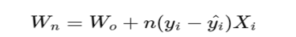
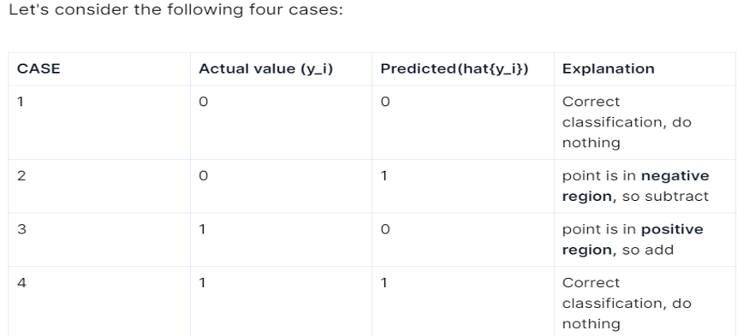
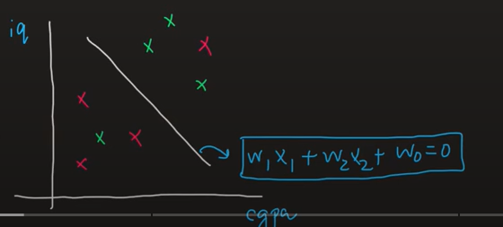
New coefficients value= old coefficients value +learning rate (model y-Predicted Y)Xi
Now we need to make changes that term should not be 0
In this term yi is data which we cannot change,we can do changes in and it is nothing but the way model predicts
How model predicts earlier(shown earlier) using step function
But if prediction will be 0,1 then term will keep on getting 0.To stop this we have to use a new function other then step function called SIGMOID FUNCTION

Slide 29
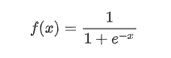
SIGMOID FUNCTION
The sigmoid function is a special form of the logistic function and is usually denoted by σ(x) or sig(x). It is given by:
The sigmoid function is also called a squashing function as its domain is the set of all real numbers, and its range is (0, 1). Hence, if the input to the function is either a very large negative number or a very large positive number, the output is always between 0 and 1. Same goes for any number between -∞ and +∞.

Slide 30
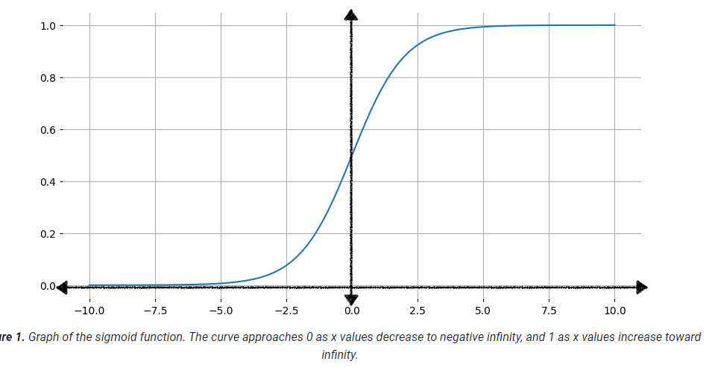
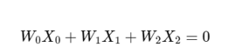
When x value is very high,then sigmoid function value will tend to 1
When x value is very highly negative then sigmoid value will be 0
When x value i0 then sigmoid value will be 0.5
Now in the same data set ,lets say we have income 80,000 and age 21 .
This we will fed in same equation
If this value is positive that means sigmoid output is greater than 0.5
If this value is negative that means sigmoid output is smaller than 0.5
Now if else loop if sigmoid output greater than 0.5 then loan approve otherwise not.

Slide 31
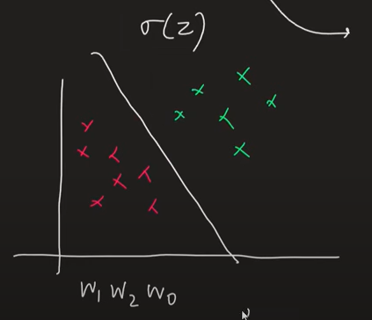
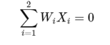
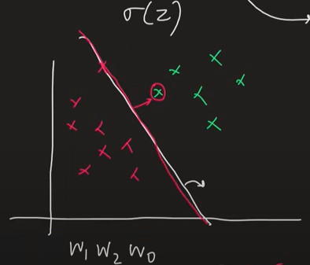
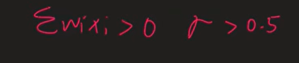
SIGMOID OUTPUT
Sigmoid output on the line will be so σ(x) =0.5

Slide 32
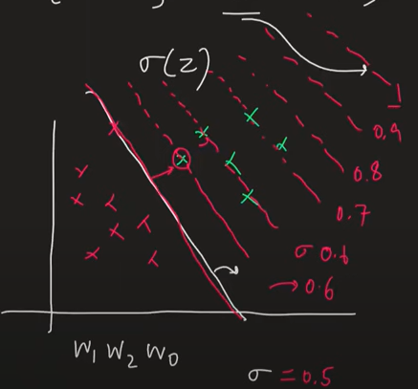
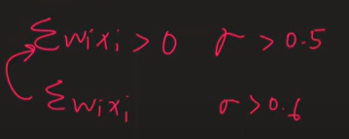
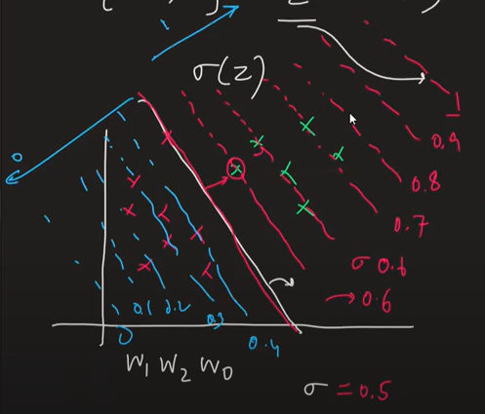
So basically sigmoid is converting this whole region in gradient

Slide 33
We can also see it in terms of probability
When we are saying that σ(x)= 0.5
That means Probability is 0.5 that means
Probability of loan get sanctioned is 0.5
If we talk about 0.6 line where σ(y)=0.6
That means all points lying on this line
has probability of 0.6 of getting loan.
So probability of not getting loan will be 0.4
That means topper will also have some prob
Of not getting placed
And worst student will also have some prob of getting placed
So gradient from 0 to 1 is gradient of loan getting approved, as far you are from 0,chance of loan getting approved is more

Slide 34
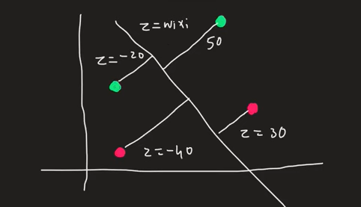
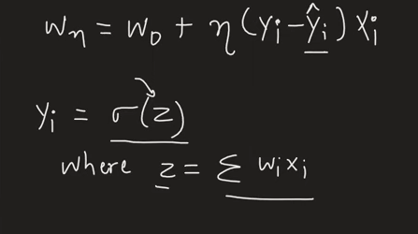
Impact of Sigmoid
Now we need to calculate e for each case.For that we need to put value of z in sigmoid.
And as big number we put in sigmoid ,we wil go towards 1 and as small number we put,we will go towards 0

Slide 35
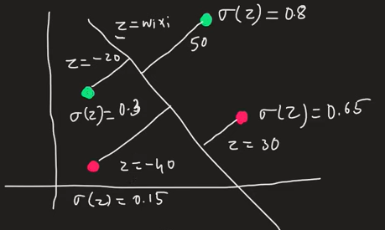
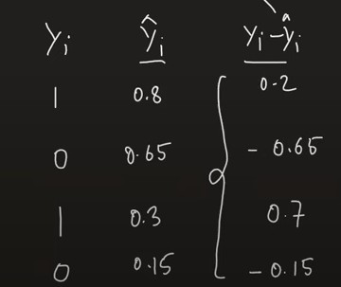

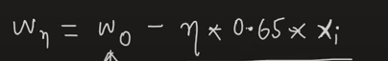
Case 1: σ(z)= 0.8 so equation will be
As we are adding something so line will be pushed
Case 2: σ(z)= 0.65 so equation will be
As we are subtracting something so line will be pulled

Slide 36
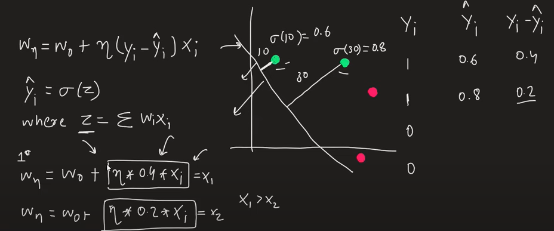
Impact of Distance on pushing force to a line

Slide 37
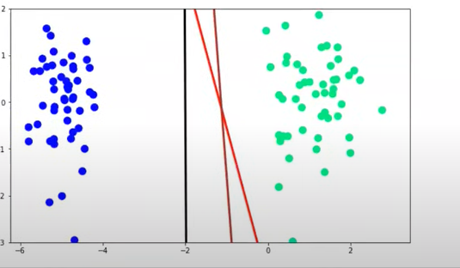
Comparison of sigmoid with step function

Slide 38
Flaw in Sigmoid function till now
We are finding a line,but there is no way to say that this is the best line.
May be after 1000 runs ,if you run more you get better solution, but there is no guarantee to tell that this is the best solution
ML always say to find a loss function or error function.
It is basically a formula to tell how much error your model is doing.
Now we will find the minima of this loss function and there the value of coefficients are the actual solution
So we have to find a loss function on this problem.

Slide 39
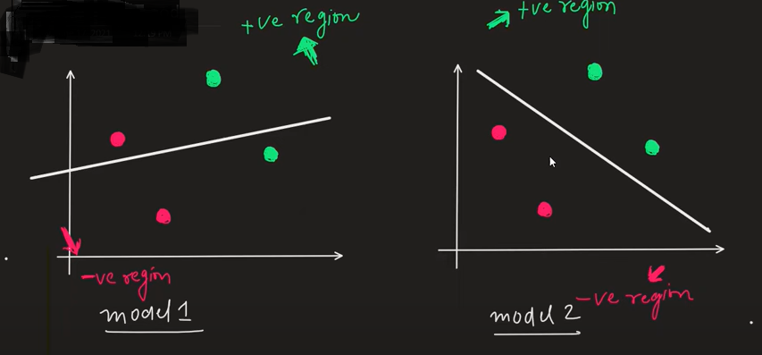
MAXIMUM LIKELIHOOD(MLE)
Which one is best model

Slide 40

Loss function help us to find which model is the best model out of many.
For that we wil use one feature of STATISTICS called maximum Likelihood

Slide 41

So now mathematically we will proof that model 2 is better than model 1 and in this we will take help of Sigmoid Function
Step1:We will calculate the predictions for all the points in the dataset
Step2:We know that for above line points value of sigmoid will be greater than 0.5 and below will be smaller than 0.5,this is what sigmoid function do. We also know that at line P(Green) is 0.5.As we go above line P(Green) will increase and as we go below line P(red) will increase.

Slide 42


Step 3:We have calculated P(green ) and P (Red) for each point in dataset for both models

Slide 43
Step4:To find out which model is better ,we will multiply prediction of all datapoints(MLE) and the model whose product is higher will be the better model but we have to take that probability of which color the datapoint is .
Model1 Maximum Likelihood=0.7*0.4*0.4*0.8=0.089
Model2 Maximum Likelihood=0.7*0.6*0.6*0.7=0.176
So model 2 is better
But it has one problem there were only 4 datapoints then product become 0.089.What if dataset will have 1000s of datapoints, product will be very small so comparison wil be useless
Step5:To make this problem removed ,we will replace product using summation using log as we know
log(ab)= log a +log b
So Log(maximum likelihood)=log(0.7) +log (0.4) +log (0.4)+ log (0.8)
But again there is one problem
We always have to take log of number between 0 to 1 and log of any number between 0 to 1 is always negative

Slide 44
To save from this problem we will take all logs as negative
Log(maximum likelihood)=-log(0.7) -log (0.4) -log (0.4)- log (0.8)
When we take summation of –ve logs of Maximum likelihood is called Cross Entropy.
So here now we are calculating Cross Entrophy rather than Maximum Likelihood.
In maximum likelihood we have to maximize it that means we have to select that model where product of maximum likelihood is maximum.
But we have to minimize cross entropy because when we take log then log(0.1)> log (0.9)
That means we have to pick that model whose cross entropy is minimum

Slide 45



Step6:Now we need to convert all of the above things in formula
This is called log-loss-error or Binary cross entropy function
Now at the end we need to minimize this error function to get value of w0 w1 and w2 such that error function should be minimized.
Now we will apply gradient descent on this loss function to find its optimum solution
Average log loss= 1/n(

Slide 46
Application of gradient Descent on Loss Function
This we will do to find most Optimised solution.
Let's suppose we have data set having m rows and n columns
Now our aim is to find Ÿ
Also since we are working on logistic regression,so number of cofficients is equal to number of input columns.
 | 1 | 2 | 3 |  |  |  |  | N | y
 | X11 | X12 | X13 |  |  |  |  | X1n | Y1
 | X21 | X21 | X23 |  |  |  |  | X2n | Y2
 | . |  |  |  |  |  |  |  | Y3
 | .
 | .
 | Xm1 | Xm2 | Xm3 |  |  |  |  | Xmn | Ym
Ÿ
Ÿ1
Ÿ2
Ÿm

Slide 47

Sp we will be having n+1 cofficients (Wo,W1.....Wn)
So we have to predict output of row 1 using cofficients
Ÿ1 = σ (Wo+W1X11+w2X12......+WnX1n)
Ÿ2 = σ (Wo+W1X21+w2X22......+WnX2n) and so on
So we can create its matrix

Slide 48


The above matrix is decomposed into dot product of two matrices.
Ÿ=σ (XW)

Slide 49




Now lets come to Loss Function
First we will convert first term into matrix then second
Converted in dot product form

Slide 50



Y log (ÿ) = Y log (σ (WX))
Similarly second term will be (1- Y) log (1-σ (WX))
So the loss function in matrix form will be
Now we are having data and loss function and we will apply gradient decend and find value of W matrix value where loss is minimum

Slide 51
https://medium.com/@sumbatilinda/deep-learning-part-2-loss-function-and-gradient-function-2f64c566a1d6
https://www.analyticsvidhya.com/blog/2023/03/campus-recruitment-a-classification-problem-with-logistic-regression/

Slide 52

For I in epochs we will update w with the following formula
Wnew= Wold-learning rate (ΔL/ΔW)
Where ΔL/ΔW is gradient
Suppose we start with random value of W .There we will find
.This collectively is called ΔL/ΔW which
will be n+1 values.
So first we will find ΔL/ΔW

Slide 53

So we will find derivative of loss function wrt w matrix
So our loss function is
Now for first term

Slide 54



For second term

Slide 55



Slide 56


Writing both terms together

Slide 57


Hence gradient descend update wil be

Slide 58
Softmax Regression

Slide 59
Hyperparameter tuning
https://scikit-learn.org/1.5/modules/generated/sklearn.linear_model.LogisticRegression.html

